Slide 1
MANAGEMENT OF INVENTORY

Slide 2
Introduction
Inventory, which consists of raw materials, components and other consumables, work-in-process and finished goods, is an important component of current assets.
There are several factors like nature of industry, availability of material, technology, business practices, price fluctuation, etc., that determine the amount of inventory holding.

Slide 3
The composition of inventory is high in food and beverages because the technology is fairly simple and hence the requirement of fixed assets is low.
The inventory requirement is high because of seasonal factor and the need for wider retail distribution net work. For instance, if each shop in the country stores twenty pockets of Maggi Noodles or Milkmaid, think of the total volume of finished goods stored in millions of shops distributed all over the country.
The composition of inventory is low in heavy industries or hi-tech industries because of high value of fixed assets.
Another interesting finding is declining trend in the composition of inventories as a percentage of total assets during the period, which partly attributes to successful implementation of new techniques such as MRP and JIT.

Slide 4
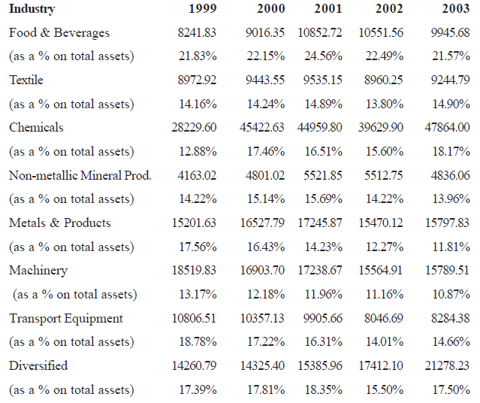
Industry-wise distribution of Inventories

Slide 5
Introduction
There are few basic differences between managing inventory and other components of assets. Unlike machine and men, the inventories are continuously planned on day-to-day basis based on the customers’ demand and production schedule.
Frequent decision-making and continuous controlling are thus required.
Unlike other components of current assets, there are number of people/ departments involved in managing the inventory. While stores department manages the materials and components, it is the production department’s responsibility in managing work-in-progress.
Finished goods are managed either by the warehouse or sales department.

Slide 6
Each division requires input from others in planning and controlling the inventory. For instance, stores department, which manages the raw material, needs to closely interact with production-planning and purchase departments to manage the raw materials effectively.
The production-planning department needs input from marketing or sales department to plan for the production schedule.
Managing inventory is complex viewing the diverse objectives pursued by each departments.
Production planning department wants to ensure timely availability of material to allow smooth functioning of production flow and thus insists that materials are purchased or drawn in advance.
On the other hand, material planning and stores department would like to procure the material only when it is required and thus reduce their stay in the stores.
Similarly, marketing dept. wants to ensure adequate stocks with the retailers or dealers or distributors. They may also insist the firm to produce more variety to fulfil different tastes of the customers and thus forcing the firm to increase the quantity and no. of materials.

Slide 7
Reasons for holding Inventory
Raw Materials and Stores
• To make production process easier
• To ensure price stability
• To hedge against supply shortages
• To take advantage of quantity discounts
Work-In-Process
• To achieve flexibility in manufacturing
• To ensure economies of production
Finished Goods
• To ensure smooth delivery schedule
• To provide immediate supply
• To achieve economies of scale
• To allow batch processing in a multiple product situation and optimize the utilization of machine and other resources

Slide 8
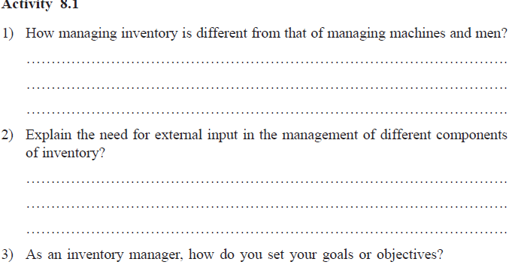

Slide 9
COMPONENTS OF INVENTORY
Raw materials - Raw materials are the input that are used in the manufacturing process to be converted to finished goods.
Examples of raw materials are iron-ore, crude oil, wood, etc. However, what is considered to be the finished goods for one firm could be the raw materials for the others.
For example steel flat is finished goods for TISCO but the same is raw material for automobile firm as Maruti Udyog or Hindustan Motors or machinery manufacturing companies such as BHEL.

Slide 10
Work-in-process
WIP: items, which are partially assembled or processed.
The complexity of production process and time required to complete production cycle determines the value of work-in-process.
The value of work-in-process is high for the manufacturers of passenger aircraft or railway engines because of complexity and long time required to complete a unit.
The value of WIP is relatively low in pharmaceutical or paint companies since its primarily mixing of chemicals.

Slide 11
Finished goods
Finished goods are the final output in any manufacturing process and are ready to be sold to the customers.
Why do firms keep finished goods in the factory or warehouse before they are sold to the customers? It is not necessary and firms can sell whatever they have produced immediately or can produce only to the extent demanded by the customers like Tata Power and NTPC, which have no finished goods.

Slide 12
Finished goods
However, it is not practical for many other firms because of the nature of production process and consumption practices of the users. For instance, Britania and Nestle, which manufacture many brands of toffees and biscuits cannot produce all of them on a daily basis to the expected consumption of their products.
They have to necessarily produce them in batches of few days or weeks requirements by using more or less same machines. They may also have to establish a large number of plants all over the country to meet the local demands

Slide 13
Finished goods
Finished goods may be relatively low for high value equipments like aircraft or ships, which are often manufactured on the basis of orders.
It can be reduced for firms, which are supplying to industrial customers because firms can schedule their production according to the production schedule of customers.
The finished goods component has to be necessarily high for firms that produce products like food products, consumer durable, etc., which are directly consumed by the public and distribution network also need to be large.

Slide 14
NEED FOR INVENTORY
Transaction Motive – An important motive for holding inventory is to perform smooth transaction in the production process and serving the customers’ demand. It makes production and delivery scheduling a lot more easier.
Precautionary Motive – Supplier’s risk, Machinery breakdown & Some amount of buffer stock. (Keeping some critical items).

Slide 15
Speculative Motive
Exploiting the opportunity that arises occasionally due to uneven demand and supply.
A refinery could buy or enter into a contract for the purchase of the crude oil when the price is cheap because of sudden increase in the supply of oil.
Textile companies find it useful to buy cotton when the prices are low since the price behaviour is volatile. It is true for most of the seasonal products.

Slide 16
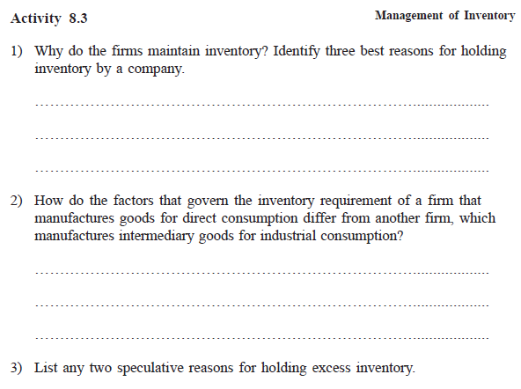

Slide 17
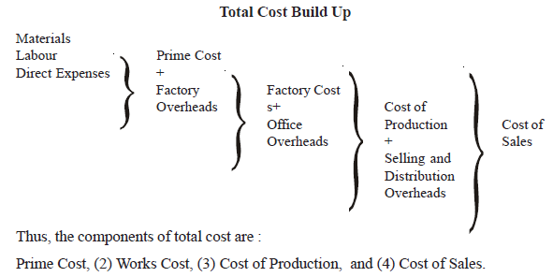
COSTS IN INVENTORY SYSTEM

Slide 18
COSTS IN INVENTORY SYSTEM
Cost of acquiring inventory –
For materials and purchased parts or components, it is the cost of purchasing, freight, inspection, etc.
This component of cost goes up when the materials are purchased in small lot because it requires frequent ordering, transportation, and inspection.

Slide 19
Cost of holding inventory
The cost of maintaining and managing stores, warehouses and other storing facilities are part of cost of holding inventory.
The losses such as spoilage, theft or obsolescence that might occur in holding the inventory are also included in the cost of holding inventory.
The most important cost of holding inventory is interest or opportunity costs associated with locking of firm’s funds for inventory.

Slide 20
Cost of inventory shortage
Its difficulty is mainly due to changes in the magnitude of the costs in different situations.
For instance, if a firm is unable to supply the goods in time, it may have different consequences.
It is possible to supply the goods with a minor delay and the buyer would perfectly accept the delayed supply.
In a different situation, the customer would refuse to take delivery because of delay and thus the firm will lose profit on this sale.
If the customer decides not to buy the product henceforth from the firm, then it is a loss of customer, which takes away all potential profits of the future.

Slide 21
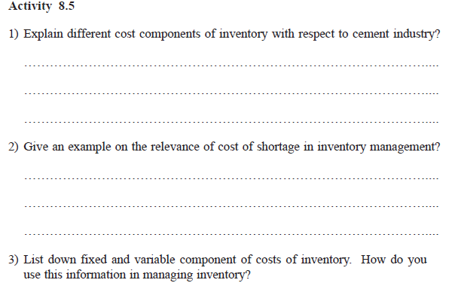

Slide 22
Stock Levels
Re-order Level: The storekeeper starts to make the purchases when the inventory in stores reaches this level.
The re-order level is fixed taking into consideration lead time and unusual delays or interruptions.
This is calculated as follows:
Re-order Level = Maximum consumption x Maximum Re-order Period.

Slide 23
Stock Levels
Minimum Level:
Inventories are not allowed to fall below this level. These are otherwise called as safety stocks in the event of emergency. If the inventory level falls below this level there is a greater chance of stock-out.
This generally happens when the consumption increases the standard requirements. This is calculated as follows:
Minimum Level = Re-order Level - (Normal consumption x Normal Re-order Period)

Slide 24
Stock Levels
Maximum Level: This is considered to be the highest level beyond which holding of inventories implies blocking of funds unnecessarily.
The good inventory control technique should keep a constant check to see that the inventory level does not rise beyond this level.
The maximum level is fixed taking into consideration the Re-order quantity, carrying costs, the availability of capital, government policy and the nature of the materials.
Maximum Level = Re-order Level + .5 (Re-order quantity) - (Minimum consumption x Minimum Re-order Period)

Slide 25
Stock Levels
Danger Level
This level is fixed even below the minimum level as a disastrous signal when the inventory level touches this level.
This has to be solved by exercising greater efforts in purchasing to bring the inventory to the required level.

Slide 26
Stock Levels
Re-order Point
This is the level at which the orders should be placed to replenish the inventory.
It takes into consideration the lead-time required to receive the inventory and the average usage. This should be a level over and above the minimum level or safety stock.
Re-order point is calculated as follows:
Re-order point = Safety stock + (Average consumption x lead time.)

Slide 27
FSN Analysis
Inventory items are also classified and controlled on the basis of fast-moving, slow-moving and non-moving items (F-S-N analysis).
The non-moving items are critically examined for their needs and items, which are not critical, are disposed off in a suitable manner.
They may be used in the production process with modifications or sold in the market.
The order levels and economic order quantity for slow-moving items are reviewed to check, whether they can be further reduced without affecting the production process.

Slide 28
VED Analysis
VED stands for Vital, Essential and Desirable.
This technique is primarily used for the control of the spare parts inventory.
The spare parts are subdivided into vital, essential and desirable categories, based on their critical nature.
The criticality is determined by the importance of its usage.
If the event of stock-out in an item stops the production, then it is classified under the ‘vital’ category.
Those spares the absence of which is not tolerated for even few hours or a day, the loss of, which is considerably high, falls under the 'essential‘ category. Desirable spares are those, the absence of which is not expected to create havoc for a week or so and necessarily would not result in the stoppage of the production.
VED analysis adopts almost the similar mechanism of the ABC analysis and the former is used for the control of spares part.

Slide 29

ABC Analysis

